Slide 1


Slide 2
Problem statement
This project deals with the data analysis of restaurant information in India. The project aims to explore hidden patterns that could affect the target variable - online order. The dataset is in CSV format and has been cleaned in the part 1 with proper data types and missing values. The project is divided into three steps.
The model that built in the above case study has gone to deployment and Zomato has been impressed with data analysis and has been believing that the analysis going to be impactful.
Now Zomato has been observing the orders happening online and offline, Due to offline orders, Zomato is not able to attract customers with diverse items and offers, and the user subscription also getting low. So, it has decided to give you the project on the same.
Now the problem statement is that Zomato wants to know whether the customer would order the orders online or offline so that Zomato can take further strategies to improve the online order.

Slide 3

Objective
The Aim is to classify the orders that have been ordered online and offline. And identify the patterns that lead to orders online orders as well as offline. Your model should be able to classify the classes effectively

Slide 4
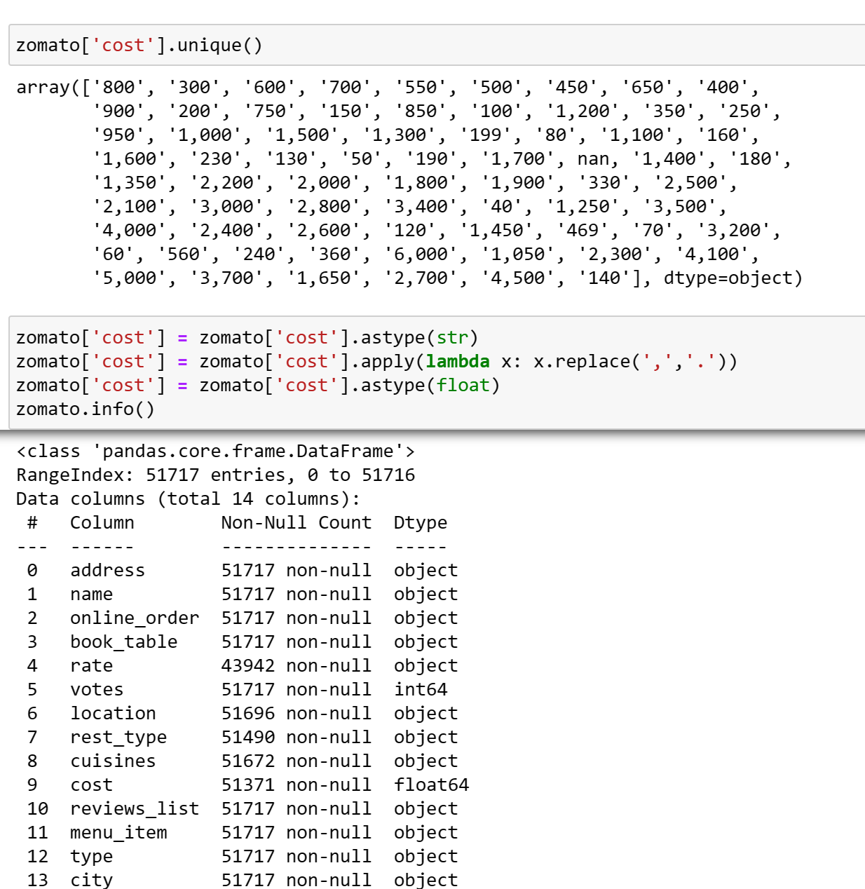
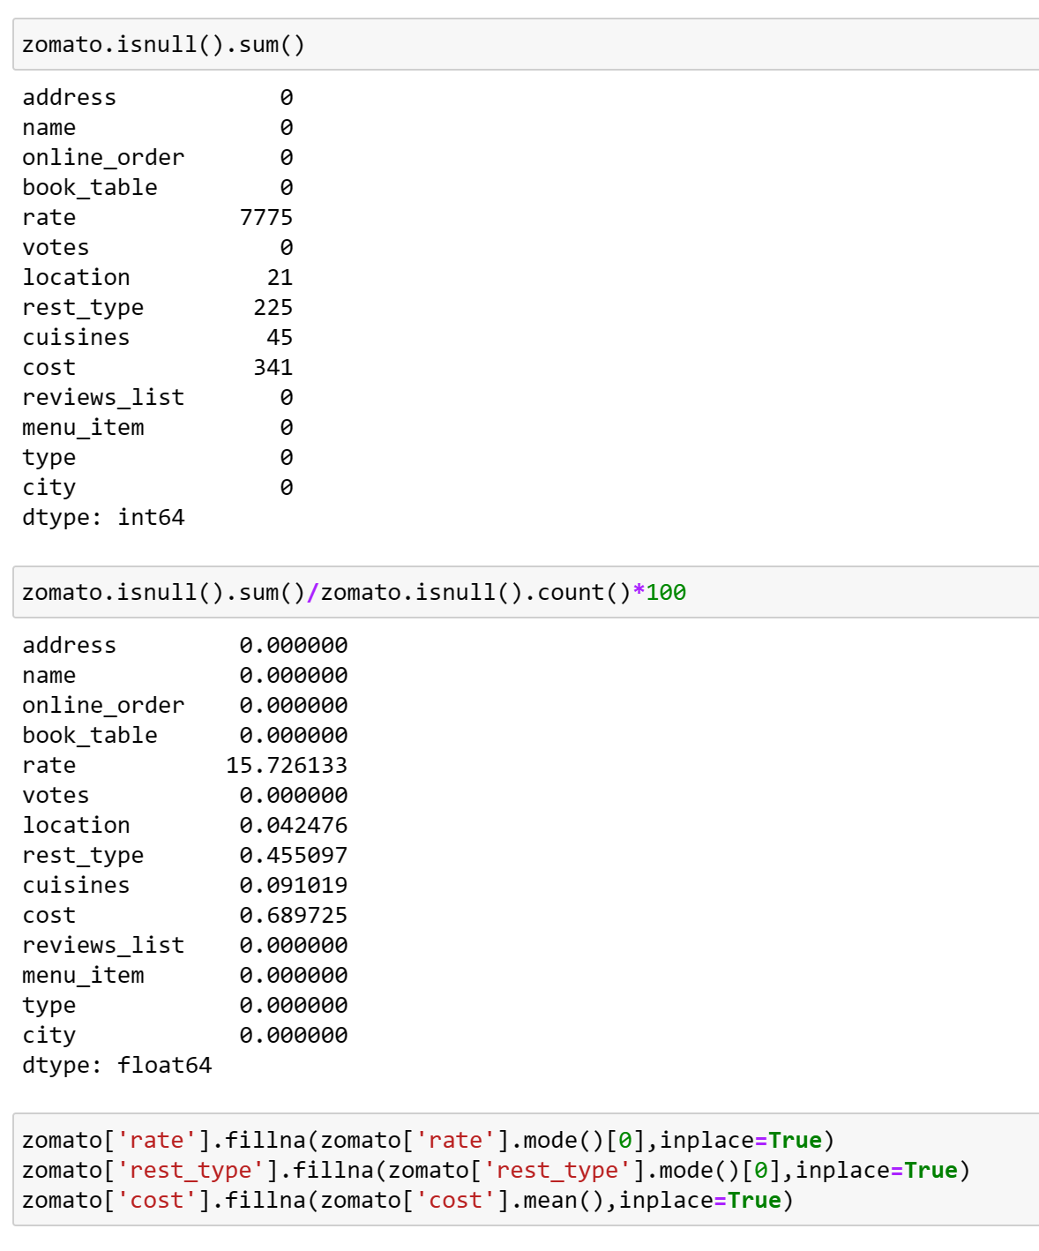
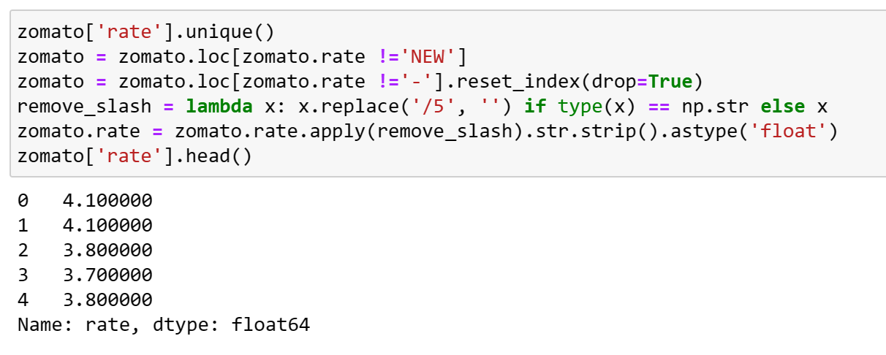
DATA CLEANING
Cleaning the data by replacing the null values with median values and drop the unwanted records.

Slide 5
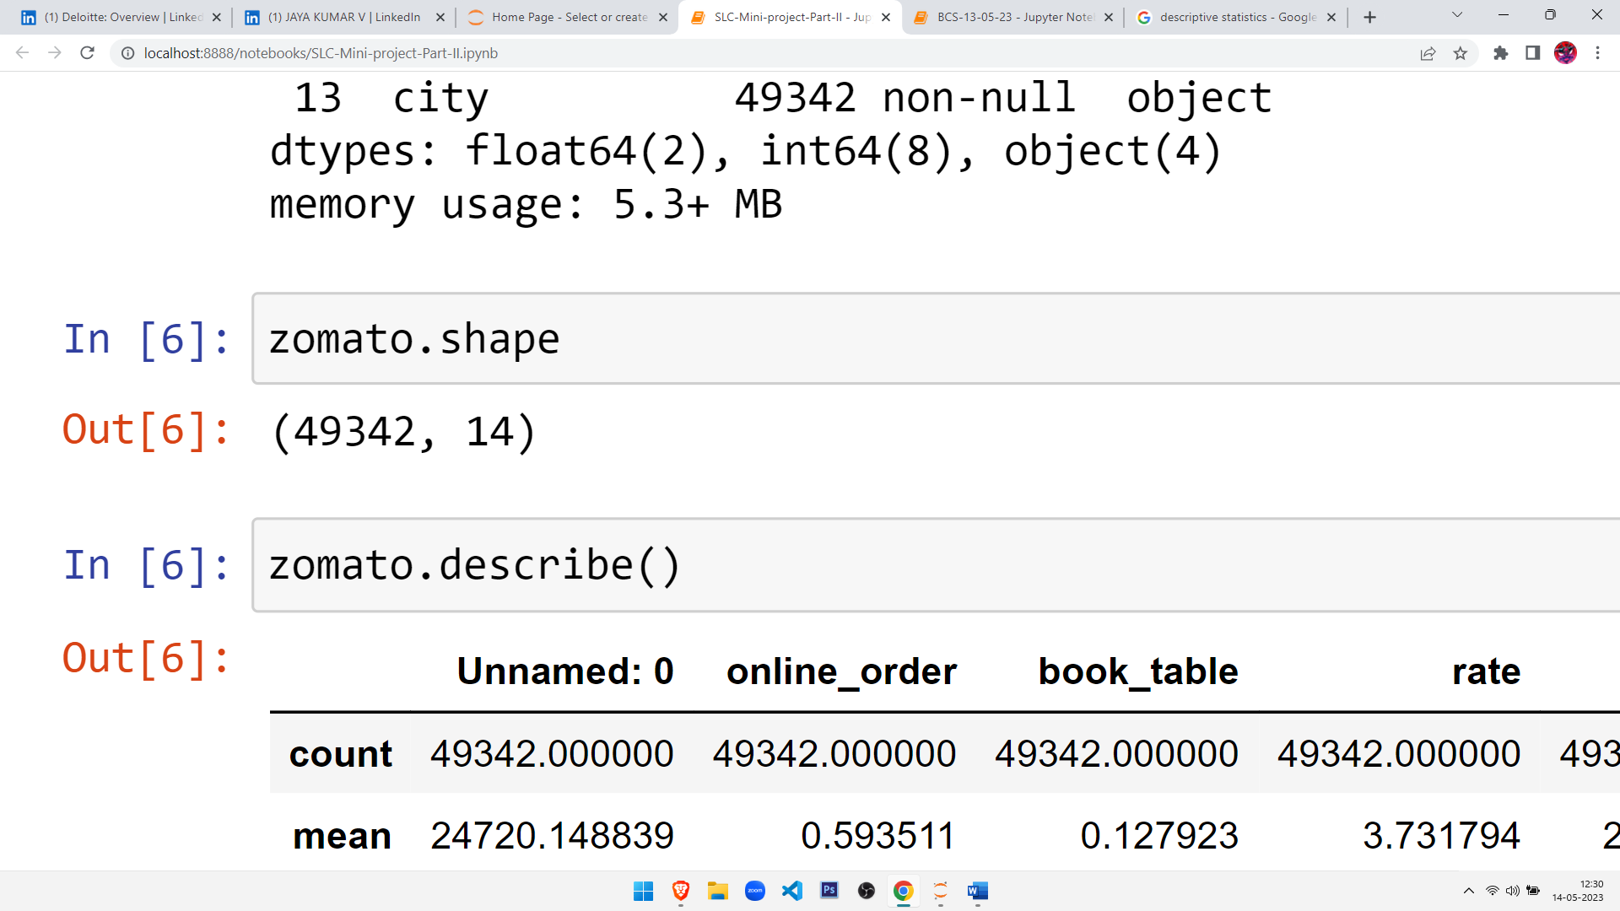
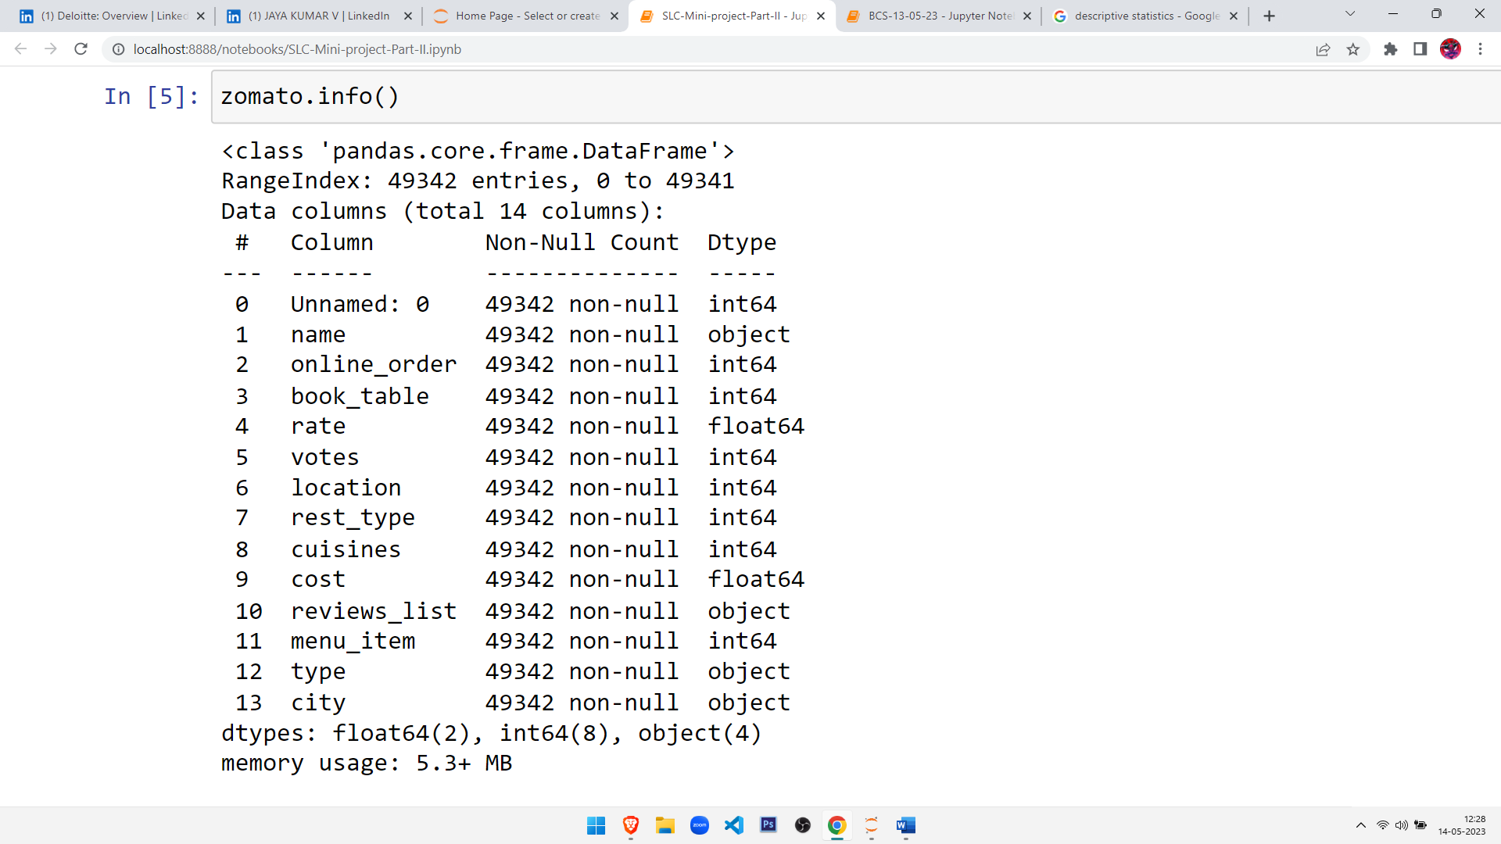
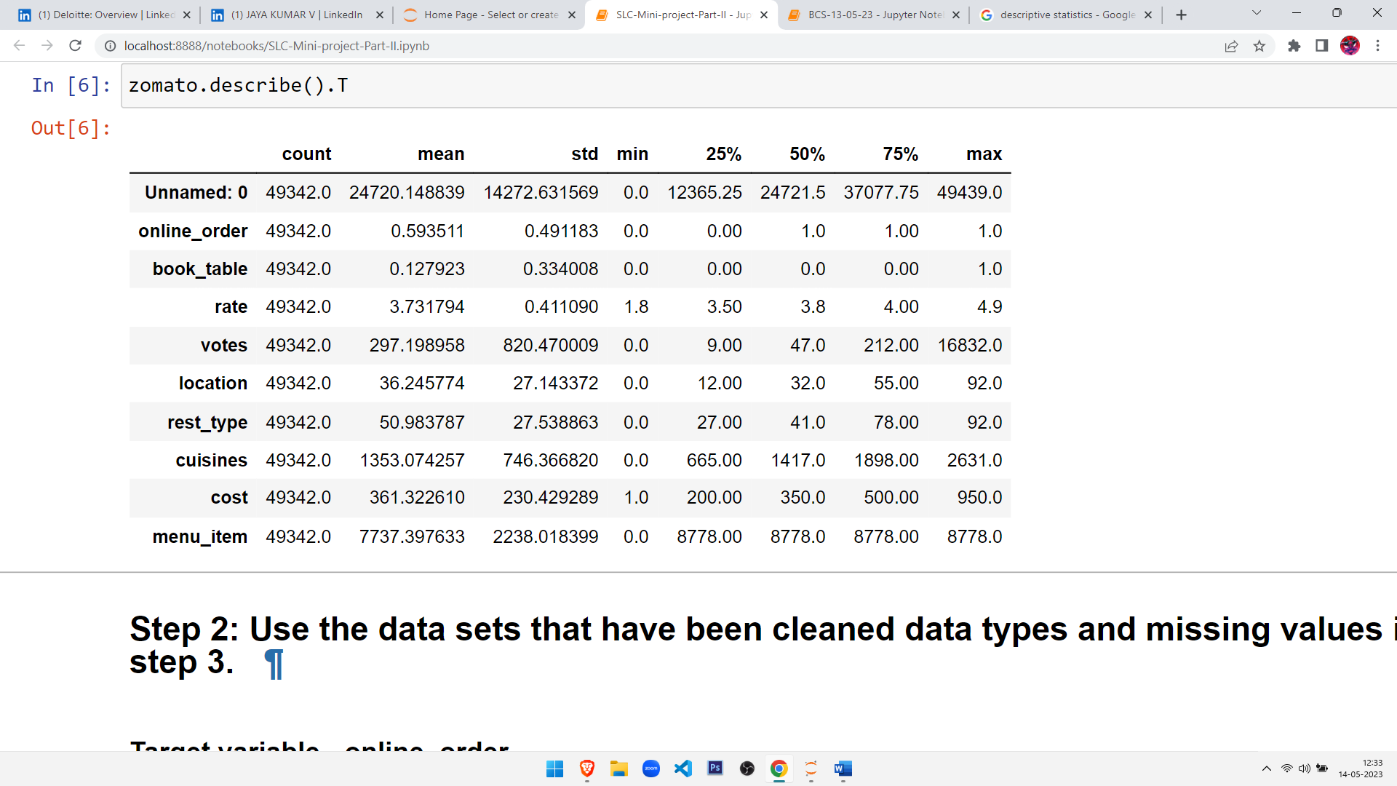
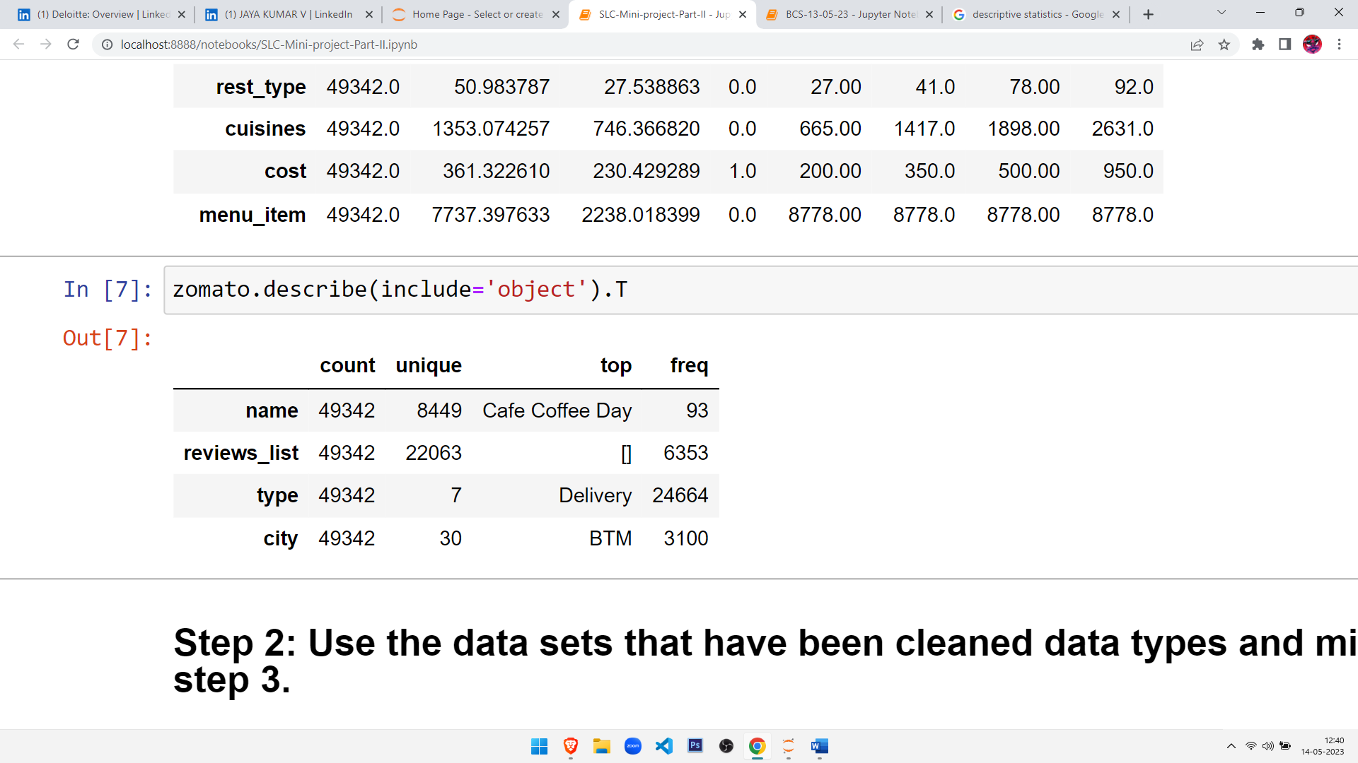
Some Statistical Inferences
We come to know that there are 49342 rows and 14 columns.
We come to know that there are 2- Discrete series, 8- Continuous and 4- object datatype from the above.
We come to know that there is no missing value in the given dataset

Slide 6

Data Analysis:
The project analyses the dataset and finds hidden patterns that could affect the target variable - online order. The analysis is divided into two parts: Univariate Analysis and Bivariate Analysis.
Univariate Analysis:
The univariate analysis analyses the variables individually. The project plotted the cost of online order vs. No online order to see the distribution of the target variable.
Bivariate Analysis:
The bivariate analysis analyses the relationship between two variables. The project visualized the relationship between the target variable and important features such as location, book table, type, city, and cost
Multivariate Analysis:
A pair plot is plotted to find the corelation between various variables in the dataset, we can’t derive a conclusion or any correlations.

Slide 7
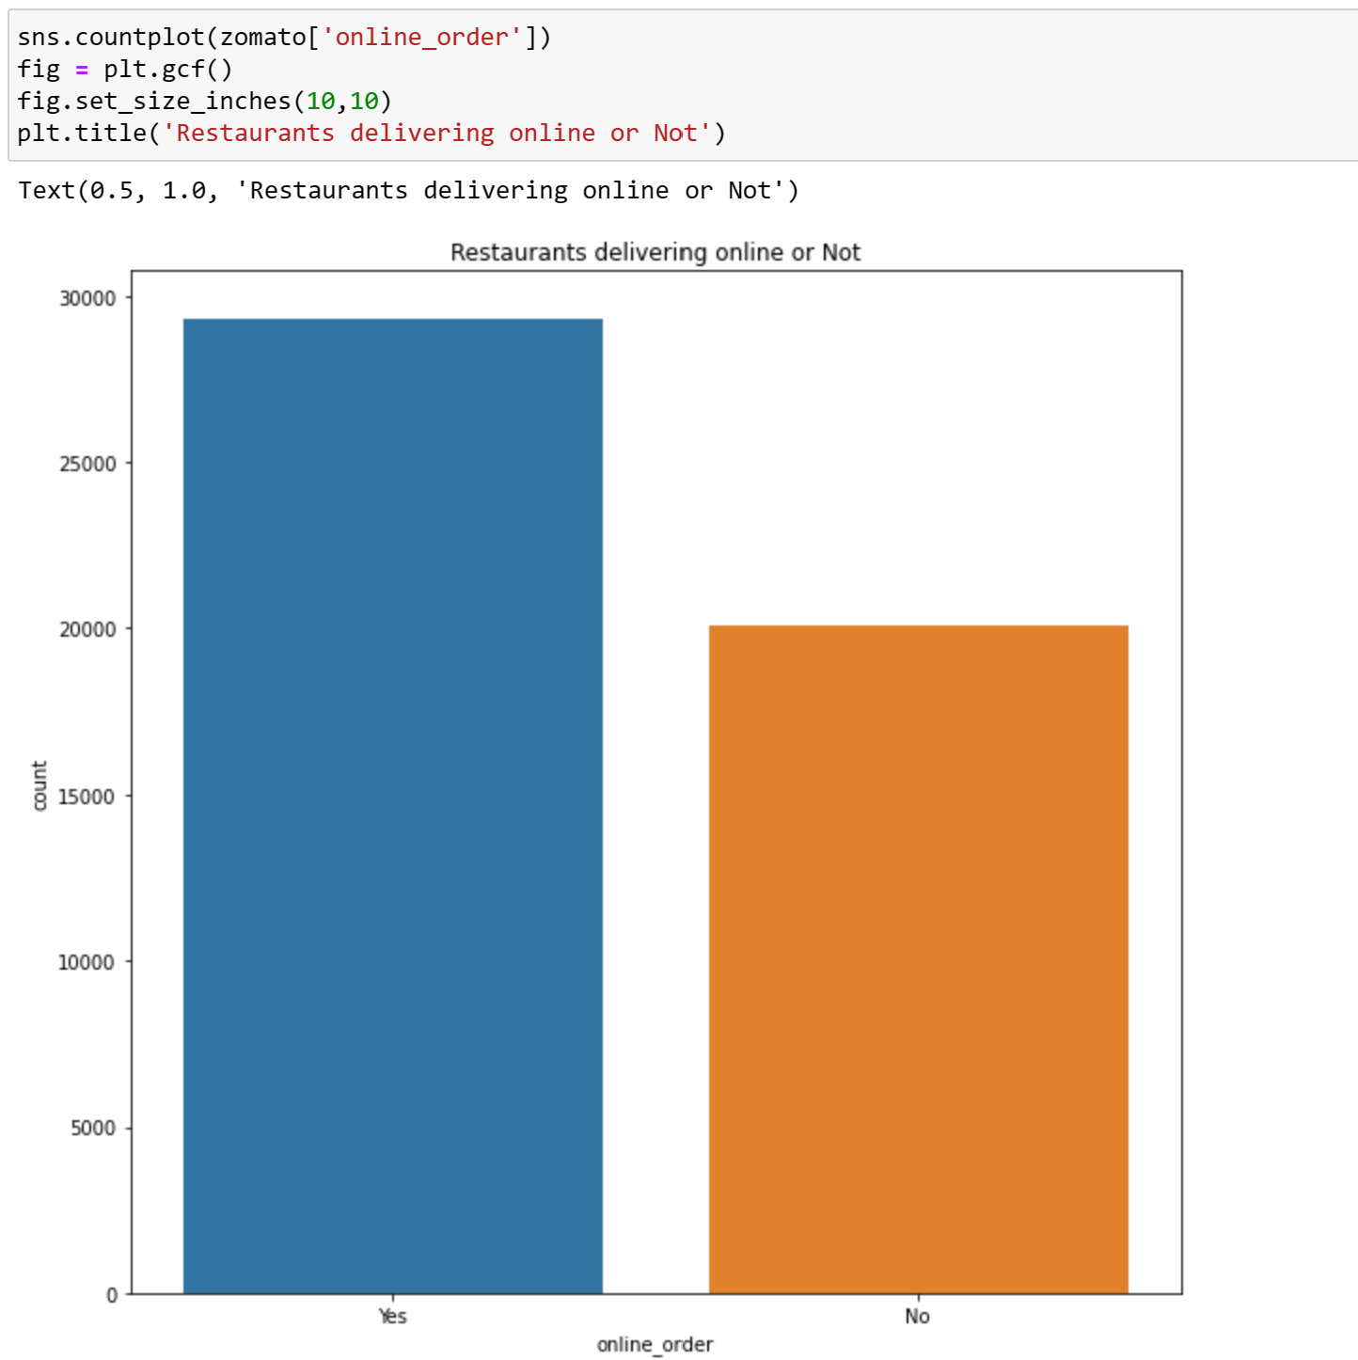
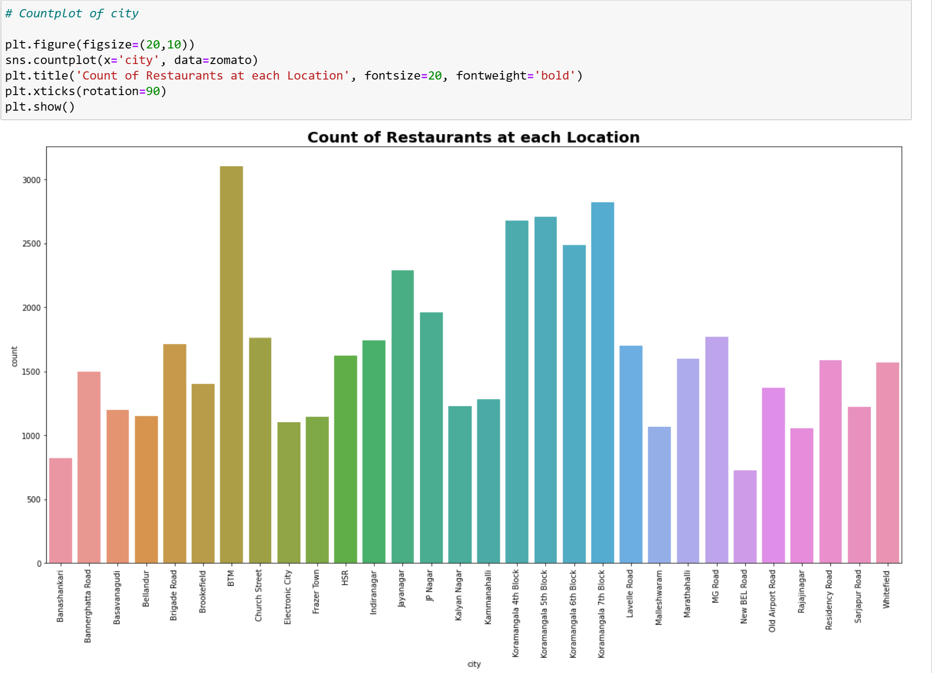
DATA VISUALIZATION
There are more than 3000 restaurants in BTM. Quick Google Search shows us that BTM is posh residential area so because of that there are quite a lot of restaurants and also it is famous for cafes. JP Nagar HSR, Koramangala 5th block, Whitefield, Indiranagar have more than 2000 restaurants and Jayanagar, Marathahalli, Bannerghatta Road have more than 1000 restaurants.

Slide 8
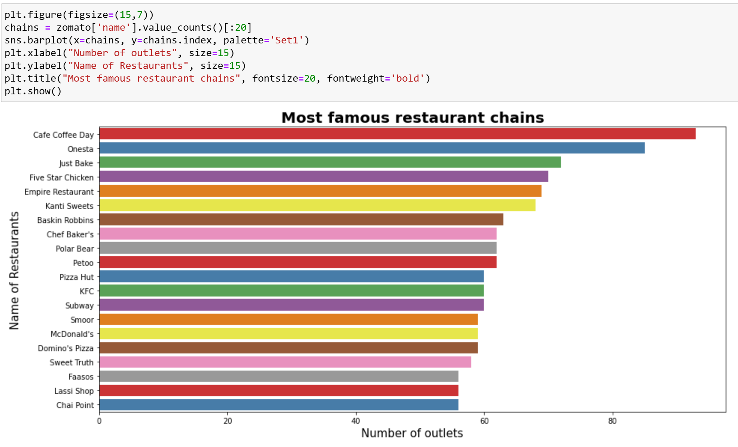
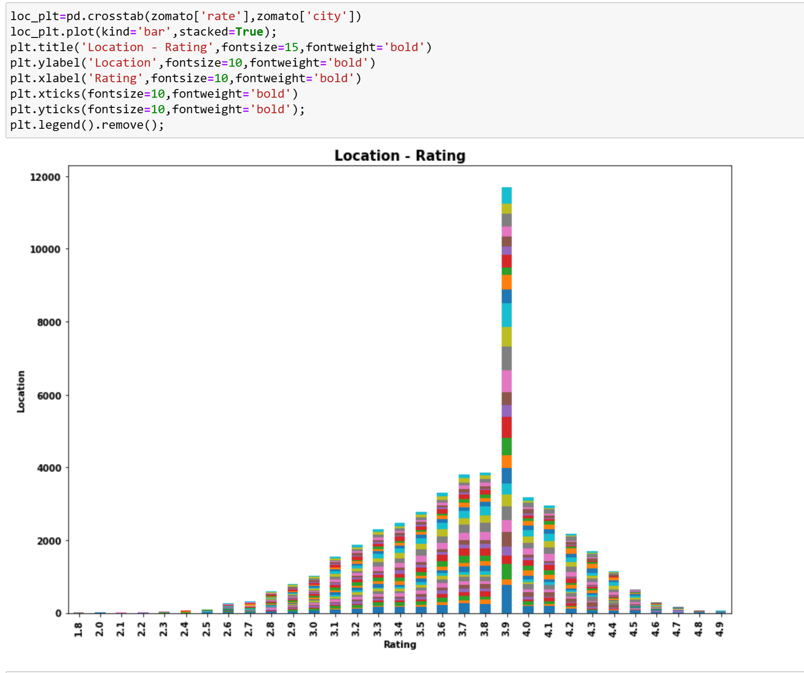
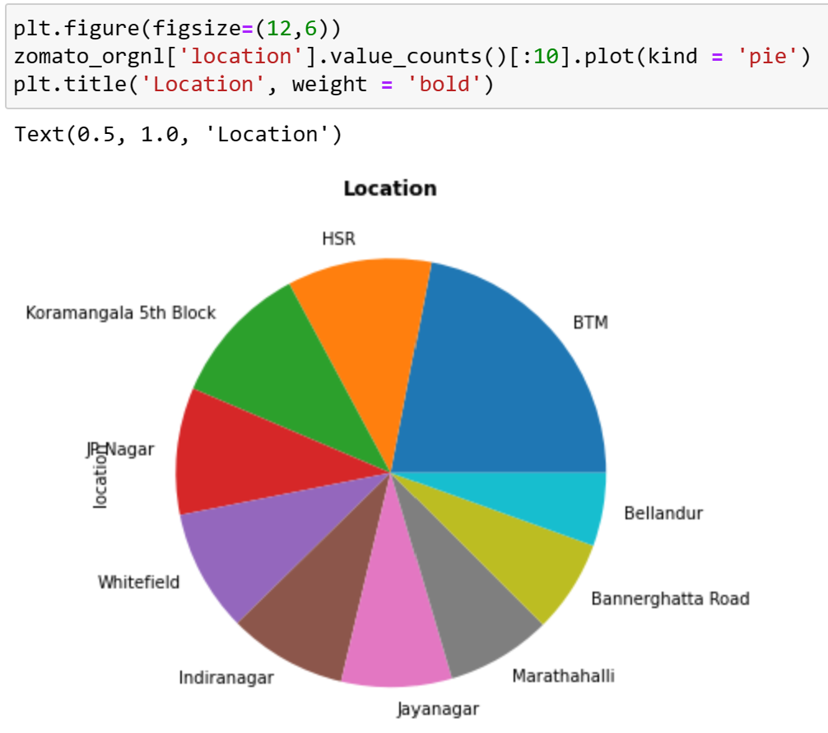
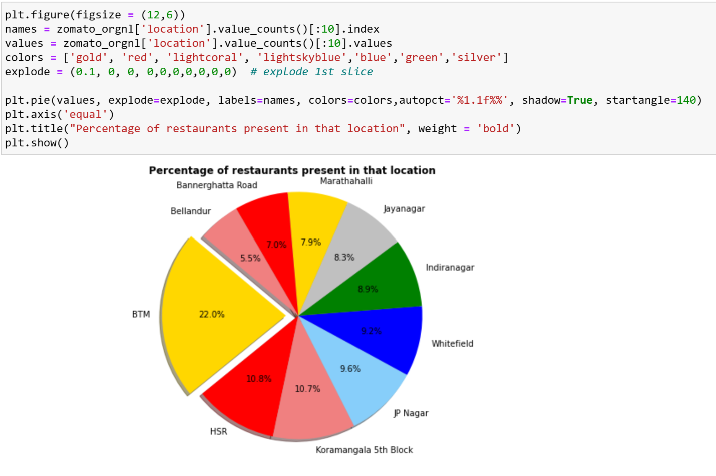
DATA VISUALIZATION
Given some Visualization plots to get more understanding of data

Slide 9
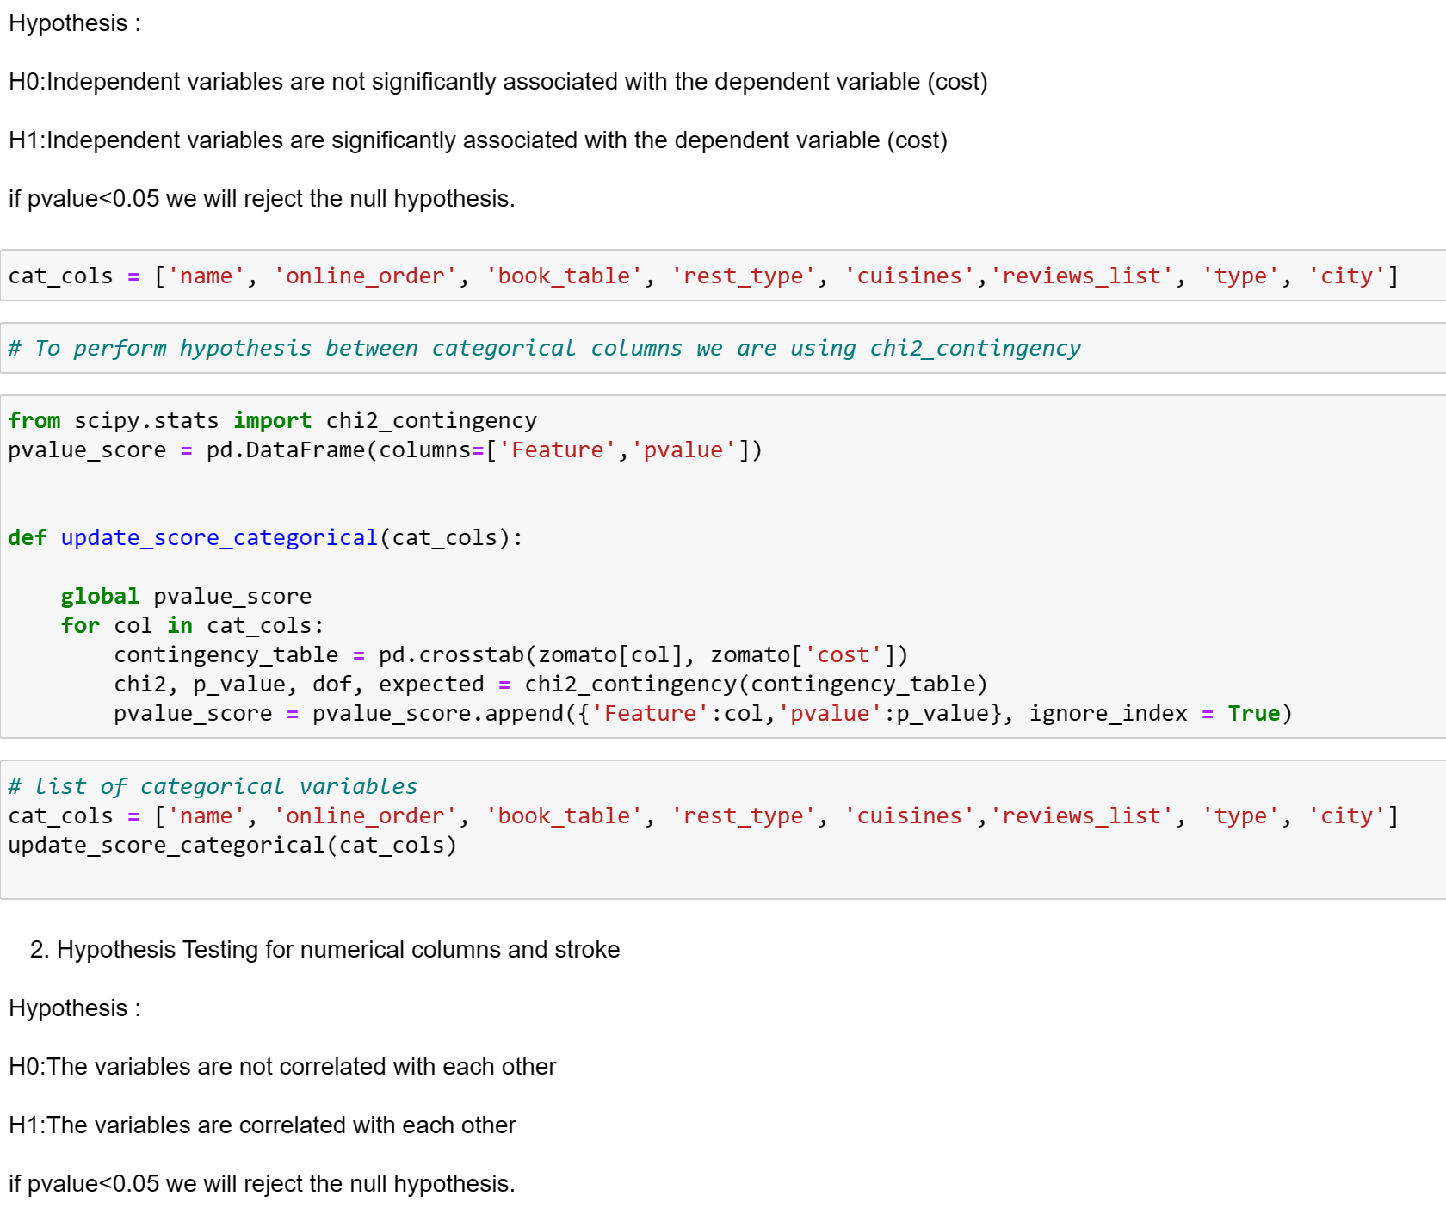
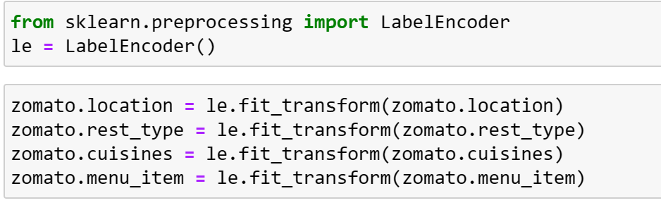
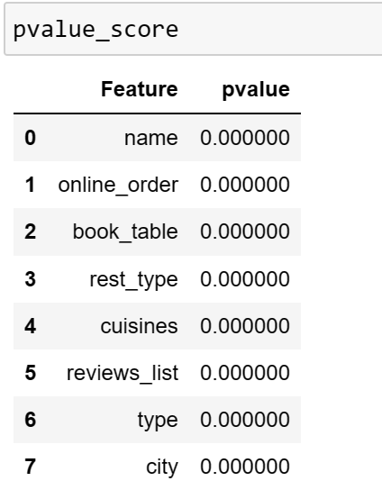
ENCODING AND HYPOTHESIS
Hypothesis Test proves that all the Variable are correlated with each other
We used LabelEncoder to transform the data.

Slide 10
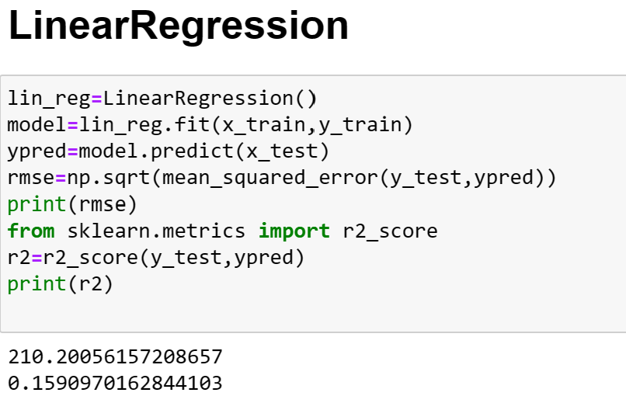
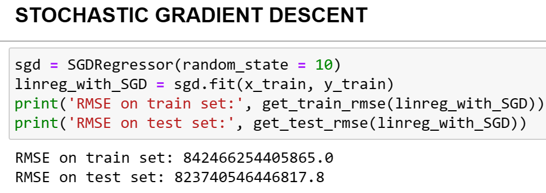
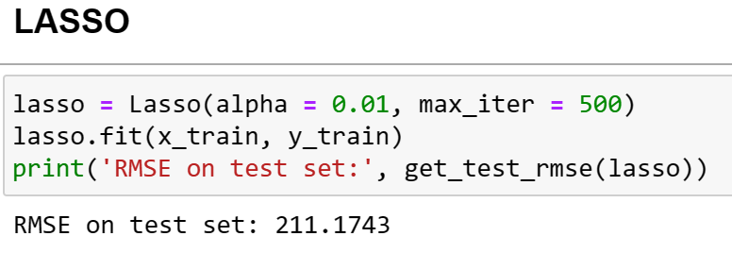
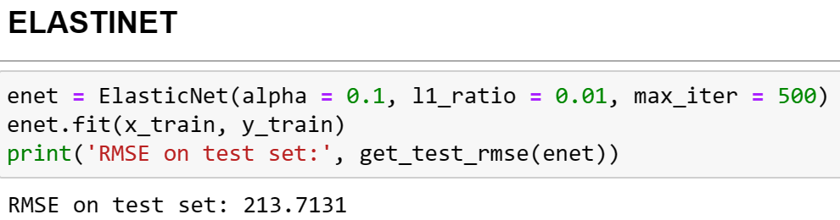
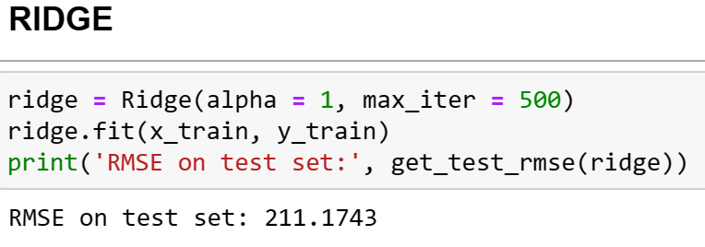
MACHINE LEARNING MODELS

Slide 11
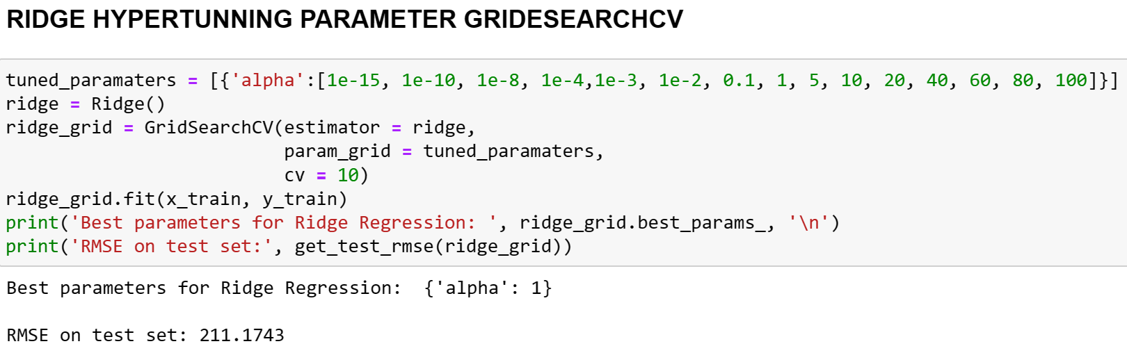
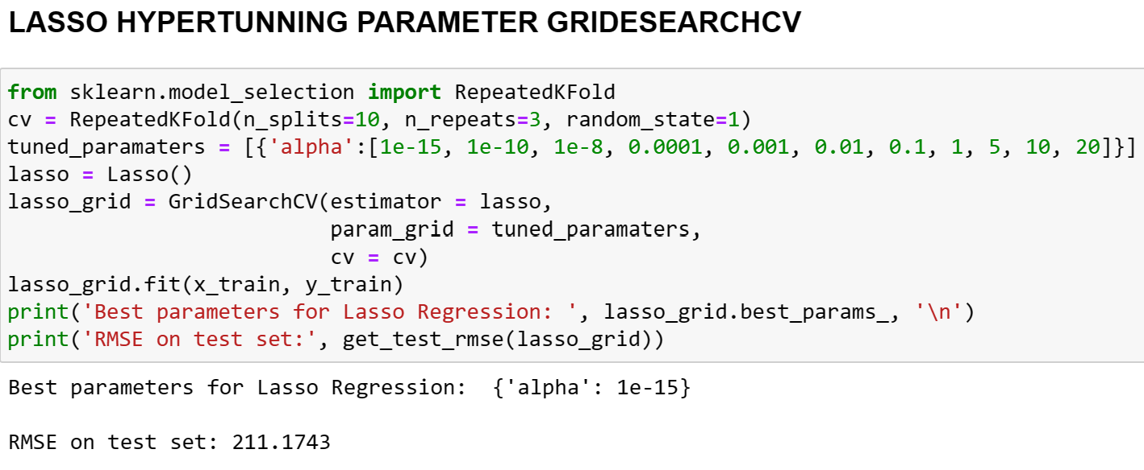
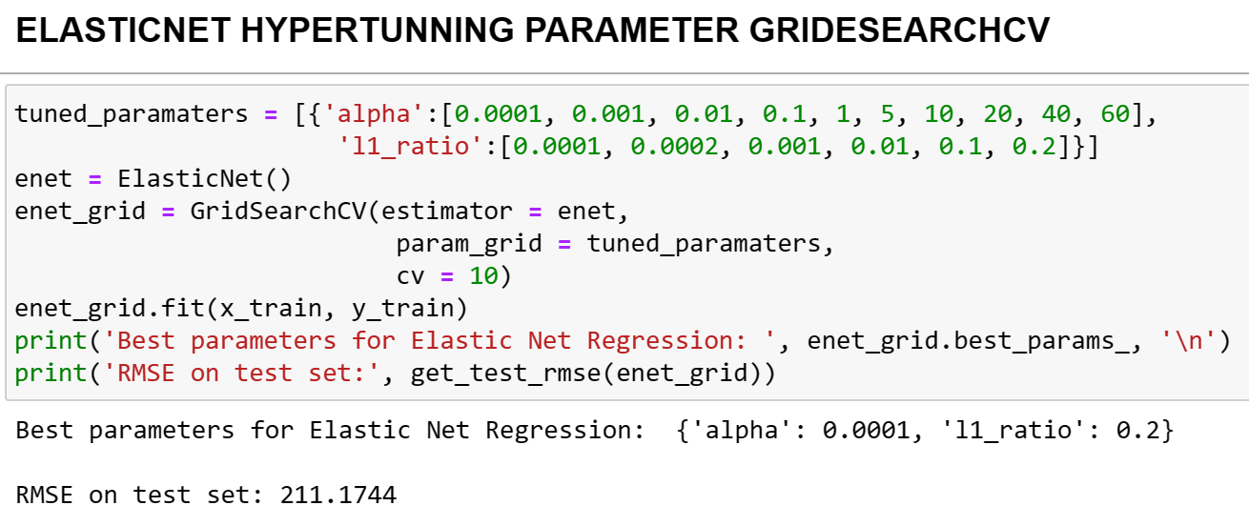
MACHINE LEARNING MODELS
Hyperparameter Tunning using GrideSearchCV

Slide 12
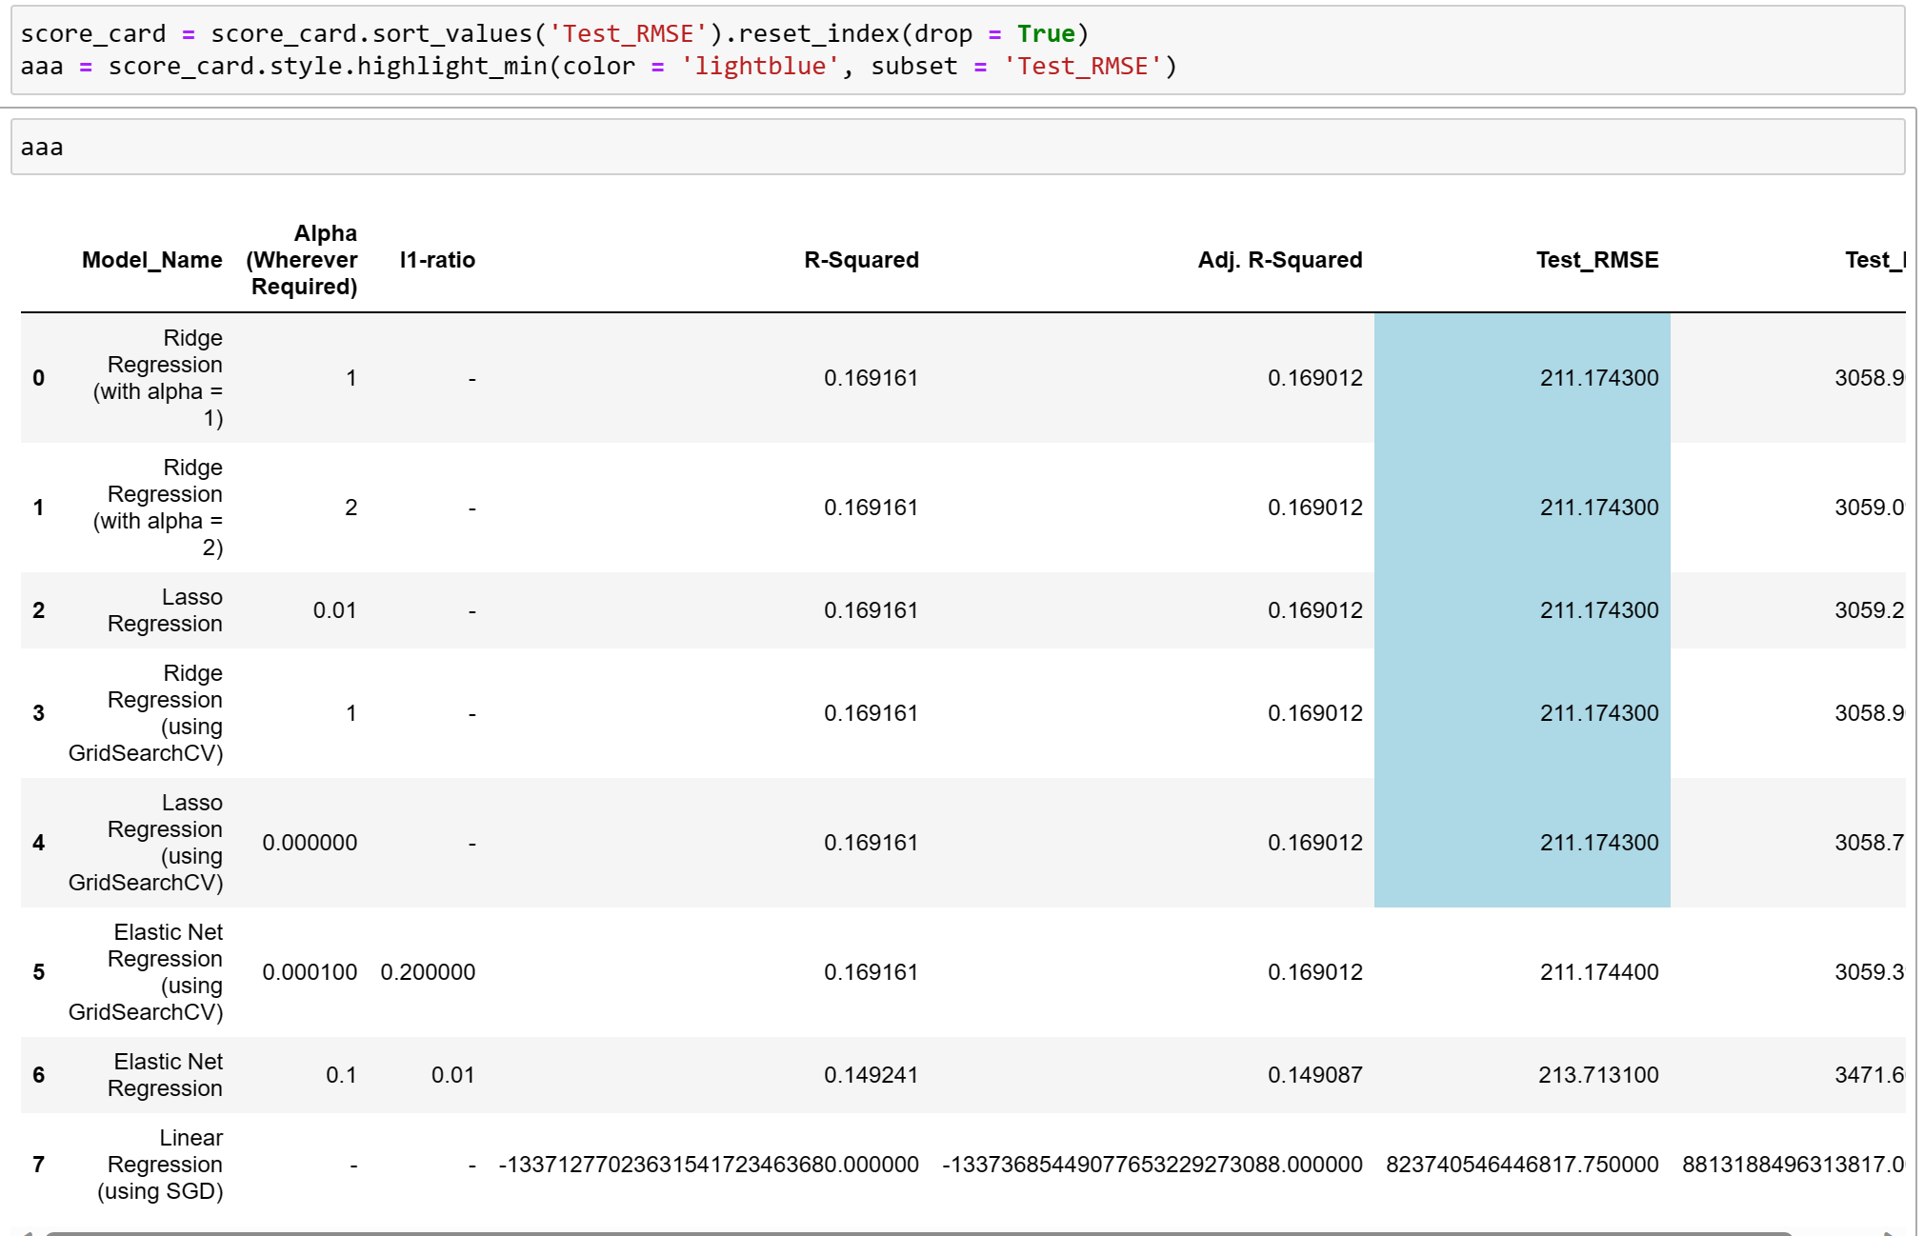
MODEL RESULT
Test RMSE is similar for 5 models. So we took Test MAPE and concluded that LASSO Regression using GridSearchCV performs well.

Slide 13


